Slide 1

Angular
JAVA FSD/MERN/MEAN (Expert & Instructor)
By Sonam Soni(B.E.I.T.)

Slide 2
INTRODUCTION
Angular is a platform and framework for building single-page client applications using HTML and TypeScript.
Angular is written in TypeScript.
It implements core and optional functionality as a set of TypeScript libraries that you import into your applications

Slide 3
Why Angular?
A component-based framework for building scalable web applications
A collection of well-integrated libraries that cover a wide variety of features, including routing, forms management, client-server communication, and more
A suite of developer tools to help you develop, build, test, and update your code.

Slide 4
Category | Angular JS | Angular
Architecture | It supports the MVC Design. The view processes the information available in the model to generate the output. | It uses components and directives. Components are the directives with a template.
Written Language | Written in JavaScript. | Written in Microsoft’s TypeScript language, which is a superset of ES6.
Mobile support | It does not support mobile browsers. | Angular is supported by all the popular mobile browsers.
Expression Syntax | ng-bind is used to bind data from view to model and vice versa. | Properties enclosed in “()” and “[]” are used to bind data between view and model.
Dependency Injection | It does not use Dependency Injection. | Angular is supported by all the popular mobile browsers.

Slide 5
Category | Angular JS | Angular
Supported Languages | It Supports only JS | It provides supports to TS and JS
Routing | AngularJS uses $routeprovider.when() for routing configuration. | Angular uses @Route Config{(…)} for routing configuration.
Structure | It is less manageable in comparison to Angular. | It has a better structure compared to AngularJS, easier to create and maintain for large applications but behind AngularJS in the case of small applications.
CLI | It does not come with a CLI tool. | It comes with the Angular CLI tool.

Slide 6
Angular benefits
Angular supports Single Page Apps (SPA) which have the following advantages:
Better user experience
Reduced full page reloads
Better overall performance
Less network bandwidth

Slide 7
Angular benefits
Angular supports proven software patterns and practices such as Model View Controller (MVC), Model-View-ViewModel (MVVM), and Dependency Injection (DI).
Angular follows declarative programming which has the following features:
Better readability and concise code
Better developer productivity
Faster development

Slide 8
Imagine a Blog site

Slide 9
Imagine a Blog site

Slide 10
Single Reusable page component
In Angular

Slide 11



Angular Possibilities
It is a fantastic tool for the programmers who basically wants to develop any kind of web application.
With technologies like Native script and Ionic its become a tool for mobile apps as well.

Slide 12
How to Work with Angular
Let’s Install:
Npm install –g @angular/cli
Once its is installed successfully check version:
Ng version

Slide 13
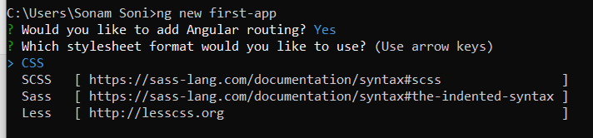
Create Angular Application
ng new app-name
ng new first-app

Slide 14
How to create App with default routing and CSS
Use –routing to add default routing
Use –style and give the style value which you want to give

Slide 15
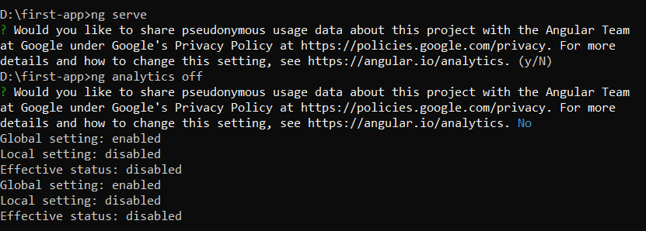
Run Angular Project
Use ng serve command to run

Slide 16
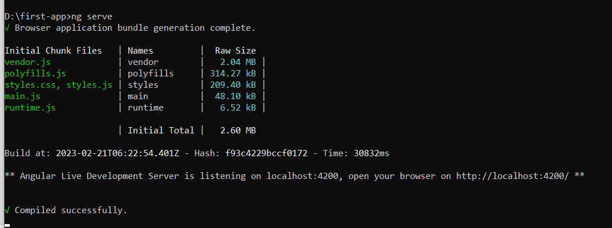

Slide 17
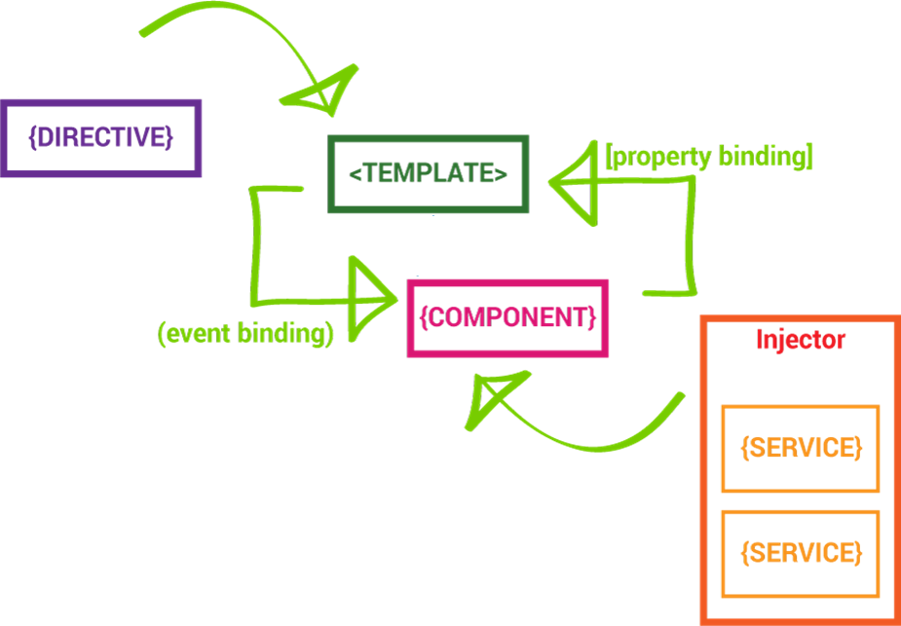

Slide 18
The Main Building Blocks
Module
Component
Metadata
Template
Data Binding
Service
Directive
Dependency Injection

Slide 19
Bootstrapping the APP
Import the bootstrap module
Import your top-level component
Import application dependencies
Call bootstrap and pass in your top-level component as the first parameter and an array of dependencies as the second

Slide 20
Module
Uses ES6 module syntax
Angular 2 applications use modules as the core mechanism for composition
Modules export things that other modules can import
Keep your modules fine-grained and self-documenting

Slide 21
Components
Components are just ES6 classes
Providers (Services) are injected in the constructor
Need to explicitly define providers and directives within the component decoration
Hook into the component lifecycle with hooks
Properties and methods of the component class are available to the template

Slide 22
Components
App
NavBar
Sidebar
Search
Products
Product
List
Product
Form
Product
Detail
Rating
Encapsulate the template, data, and the behavior of a view
Allows you to break a complex web page into smaller, manageable, and reusable parts
Plain Type Script class
Promotes:
Reusability
Maintainability
Testability

Slide 23
Components in Real Application
NavBar { }
{ }
Sidebar
Course { }
Course { }
Course { }

Slide 24
Metadata
Metadata allows Angular to process a class
We can attach metadata with TypeScript using decorators
Decorators are just functions
Most common is the @Component() decorator
Takes a config option with the selector, template(Url), providers, directives, pipes and styles

Slide 25
Template
A template is HTML that tells Angular how to render a component
Templates include data bindings as well as other components and directives
Angular 2 leverages native DOM events and properties which dramatically reduces the need for a ton of built- in directives
Angular 2 leverages shadow DOM to do some really interesting things with view encapsulation

Slide 26
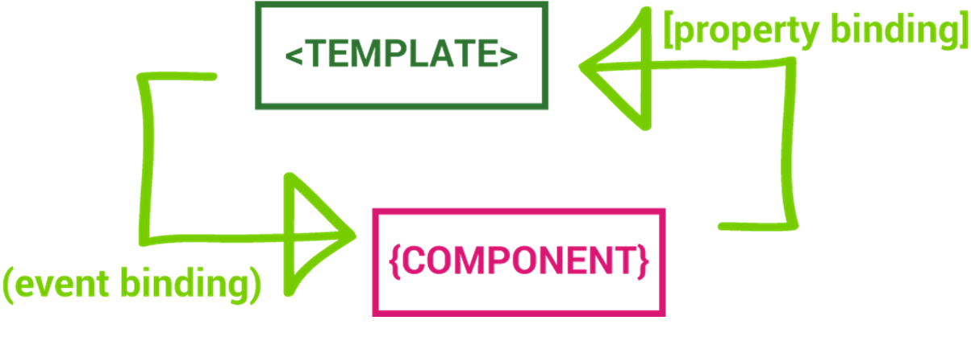

Slide 27
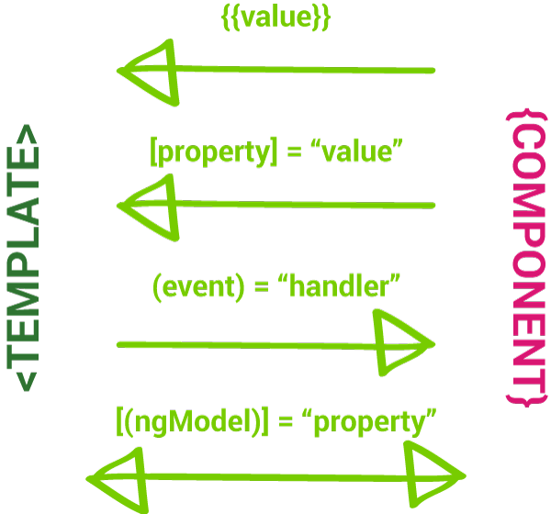
Data binding
Enables data to flow from the component to template and vice-versa
Includes interpolation, property binding, event binding, and two-way binding (property binding and event binding combined)
The binding syntax has expanded but the result is a much smaller framework footprint

Slide 28
String Interpolation
The type of one-way data binding where text is between a set of curly braces often uses the name of a component property.
Angular replaces that name with the string value of the corresponding component property.
The syntax of string interpolation is to use double curly braces:
{{ code }}

Slide 29
Property Binding
Property Binding allows us to bind the view of the template expression.
Property binding in simple term is defined as updating the value of a certain variable in component (model) and displaying it in view (presentation layer).
This is a one-way mechanism, thus it allows you to change the value whenever you want but only at the component level.

